Slide 1
Fun with LoRa and Ham Radio

Slide 2
Who am I?
Ben Jackson, N1WBV
Licensed since 1995
Salty digital operator since 1998
Been playing with LoRa and Meshtastic since 2024
Active with APRS and LoRA since 2025

Slide 3
Agenda
What is LoRa?
The Hardware
The Platforms
Call to Action

Slide 4
Understanding LoRa

Slide 5
What the heck is LoRa?
LoRa ("Long Range") is a spread-spectrum radio modulation technique
Developed in 2009 by a French semiconductor startup
  Now controlled by a company called SemTech
Designed for Internet of Things (IoT) devices
  Low power output
  Low power consumption
  Low data rates
1-3 mile range
  In urban environments

Slide 6
Frequencies and Bands
915 MHz (Americas)
  Most common LoRa bandin the US
  Unlicensed 902–928 MHz ISM allocation
  Hey! Also our 33cm band!
433 MHz (Europe & elsewhere)
  European ISM band
  Hey! Also our 70cm band!
Also other bands (868MHz, etc)
Most devices are stuck to a band
  Watch out

Slide 7

Why does LoRa work so well?
Claude Shannon & Information Theory
You can fit a certain amount of information in a certain amount of bandwidth over a certain amount of time over a certain distance
More information?
  More bandwidth
  More time
  Less distance

Slide 8
Spreading Factor
LoRa uses “Chirp Spread Spectrum”
Every LoRa configuration is a balance between how far a signal reaches and how much data it carries.
SF7 — Fast, Shorter Range
  Highest data rate, quickest airtime
SF9–10 — Balanced
  Common middle ground
SF12 — Slow, Longest Range
  Maximum sensitivity and reach
  Very low throughput and longer airtime per packet

Slide 9
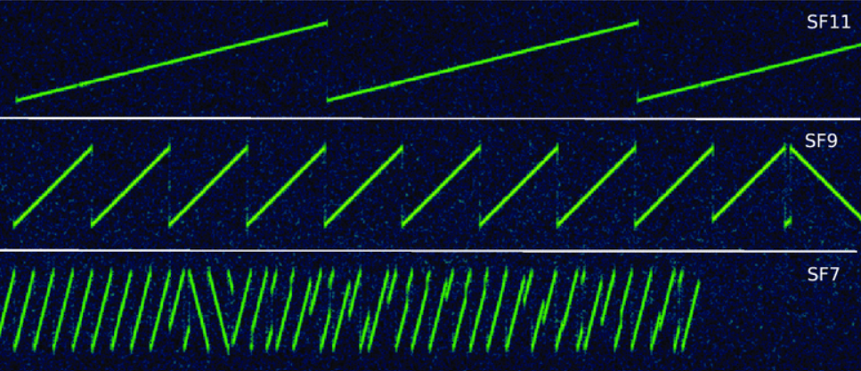
Spread ‘Em

Slide 10
LoRa Data Rates
In a word: Slow
Maximum Data Rate: 12.5Kbps
Average Data Rate: 1.7Kbps-5.4Kbps
For comparison:
  AX.25: 1.2Kbps
  802.11ah HaLow: 150-500Kbps
  WiFi 802.11ac: 3500000+ Kbps

Slide 11
The Hardware

Slide 12
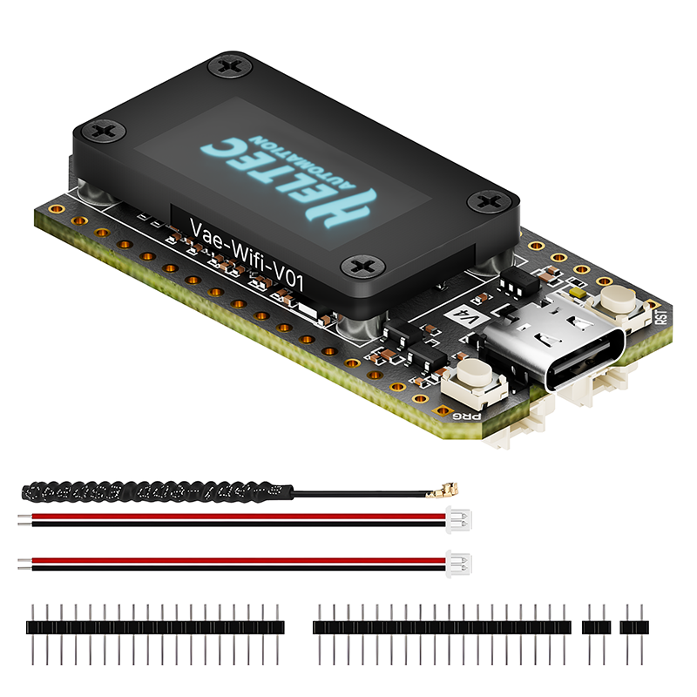
Heltec v4
915MHz Only
$30-$40
Simplest way to way to go into LoRA
Solder headers, plug in antenna, flash firmware, and go
ESP32 processor, SX1262 LoRa chip
  Power hungry

Slide 13
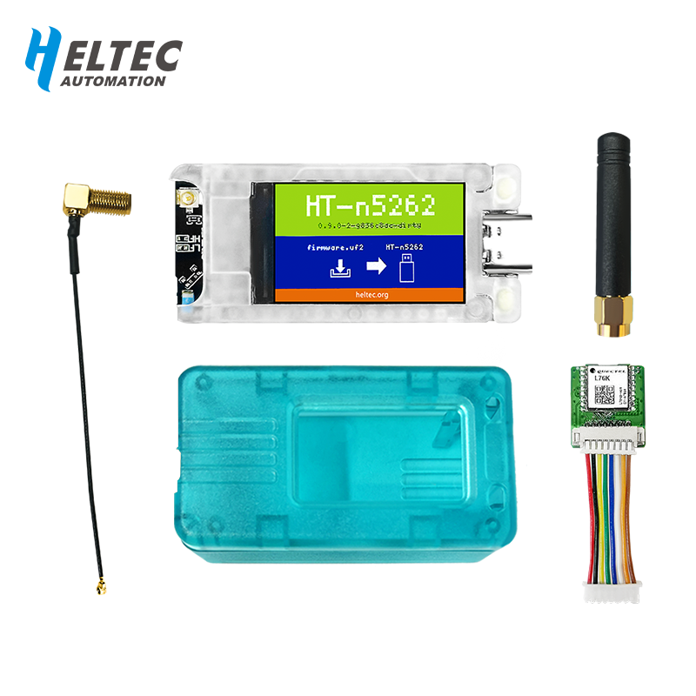
Heltec T114
915MHz/433MHz
$35-$50
Successor to the v4
nRF52840 processor, SX1262 LoRa chip
  Lower power consumption than an ESP32
Very good general purpose unit

Slide 14
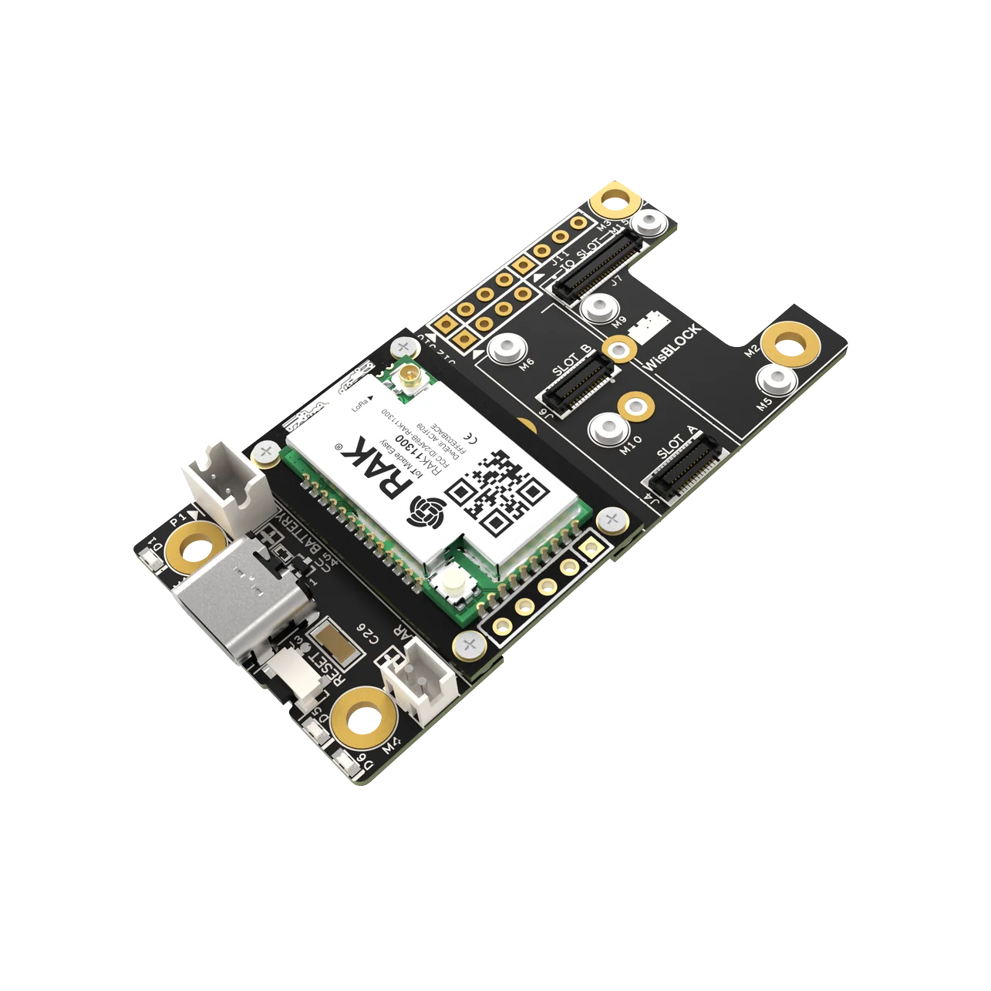
RAK Wisblock (RAK19007+RAK4631)
915MHz/433MHz
$35-$50
nRF52840 processor, SX1262 LoRa chip
Modular setup
  Teeny… tiny… modules
  Barometer, Temperature, WiFi
Frighteningly low power consumption
Perfect for unattended solar installations

Slide 15
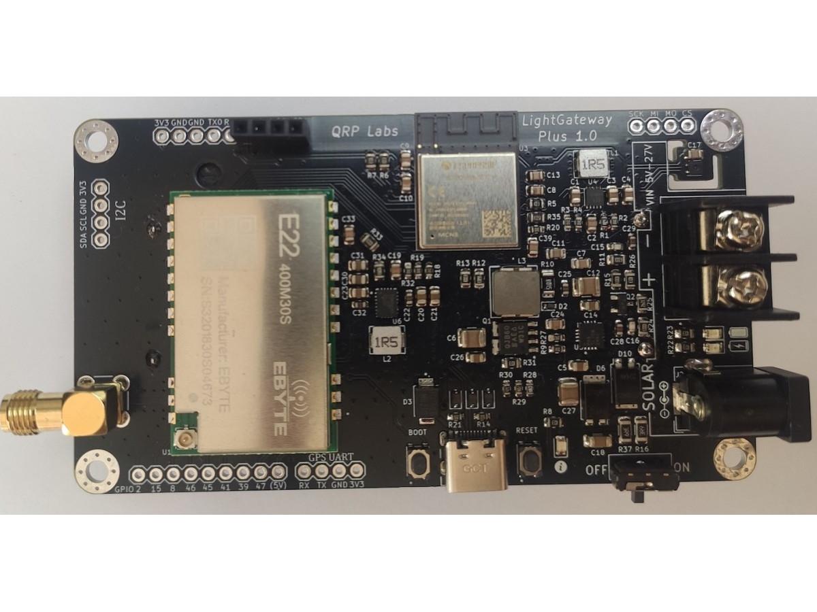
QRP Labs Light Gateway / Light Gateway Plus
433MHz Only
$45-$130
ESP32 based
Designed to be an APRS Digipeater/iGate
Open source hardware
1W Transmitter options

Slide 16
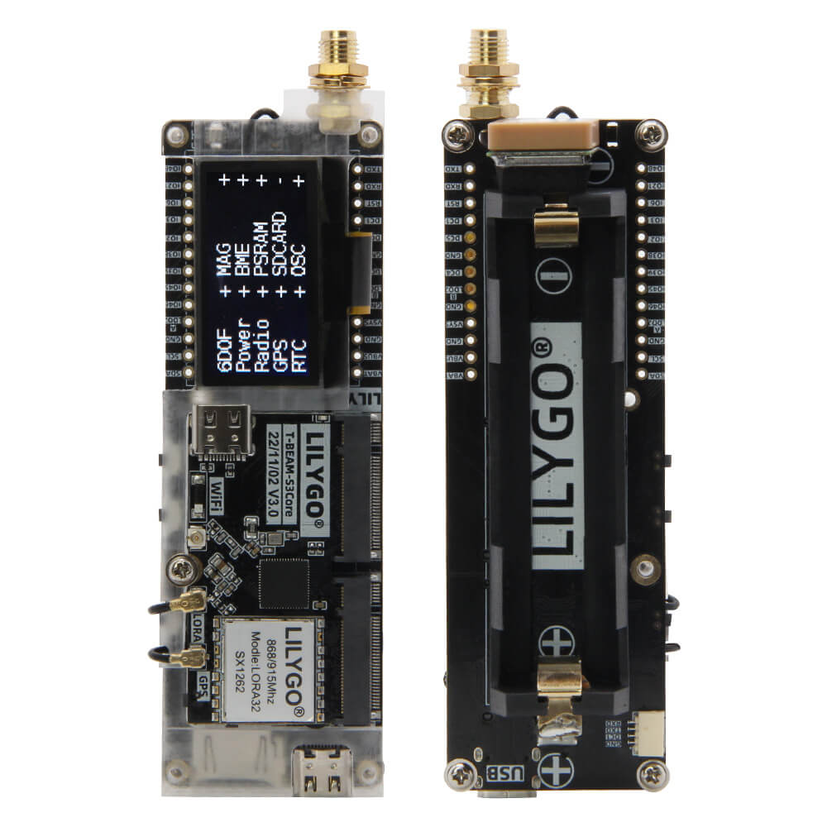
Lilygo T-Beam Supreme
915MHz/433MHz
$50-$70
ESP32 processor, SX1262 LoRa chip
Integrated 18650 cell holder
Integrated GPS
Perfect for a car tracker/transceiver

Slide 17
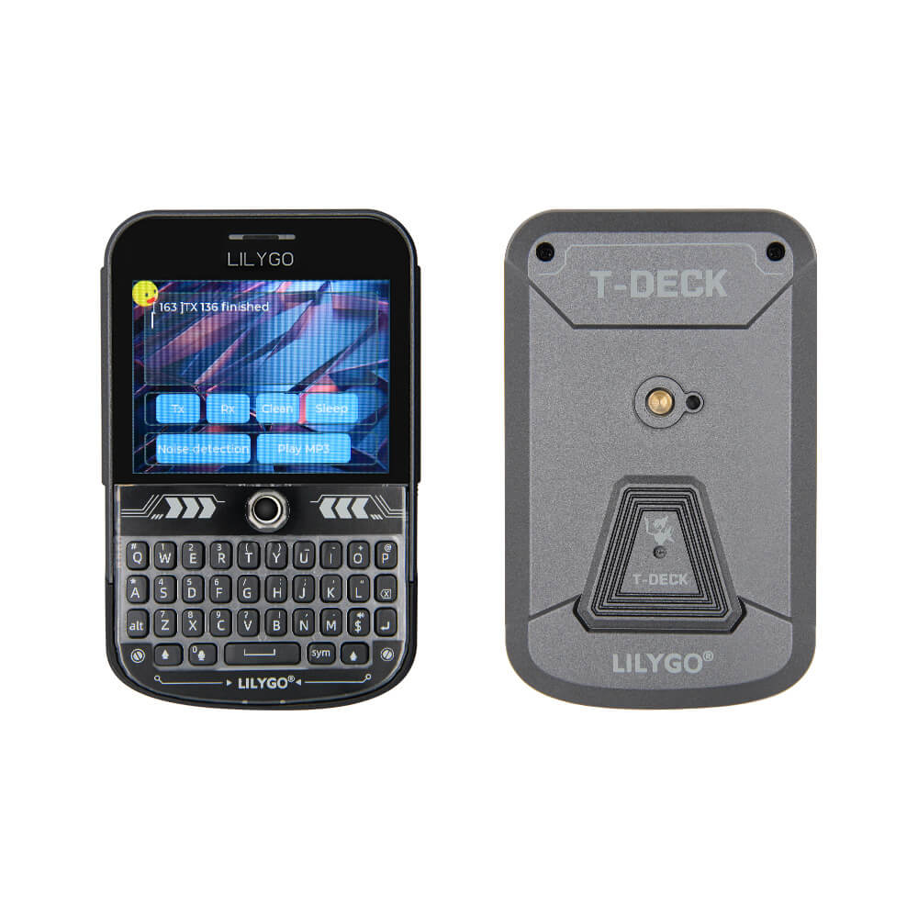
Lilygo T-Deck Plus
915MHz/433MHz
$80-$100
ESP32 processor, SX1262 LoRa chip
Integrated battery
Integrated GPS
Full screen and QWERTY keyboard
T-Deck = No case

Slide 18
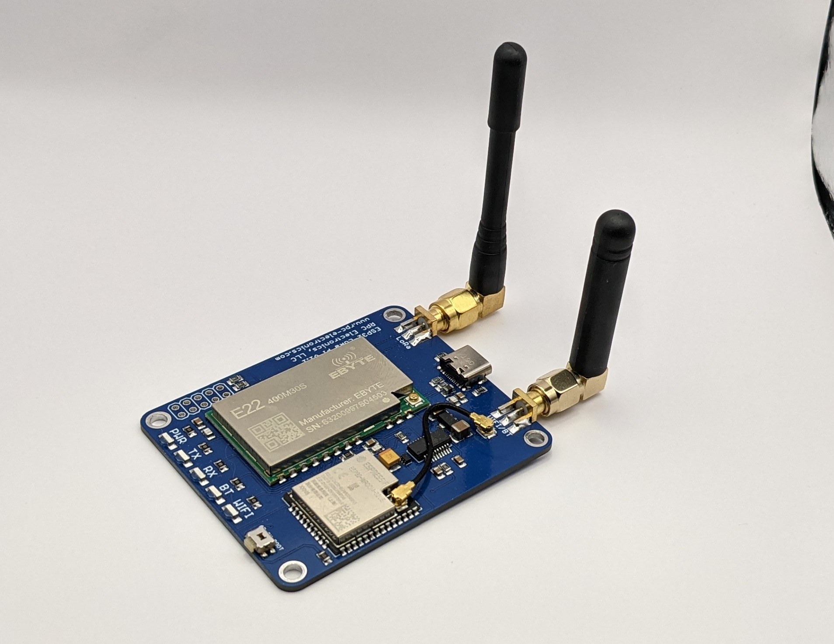
RPC Electronics ESP32 LoRA-Pi Modem
433MHz Only
$65
ESP32 based
Designed for APRS
KISS Modem capability
1W Transmitter
Easy to integrate!

Slide 19
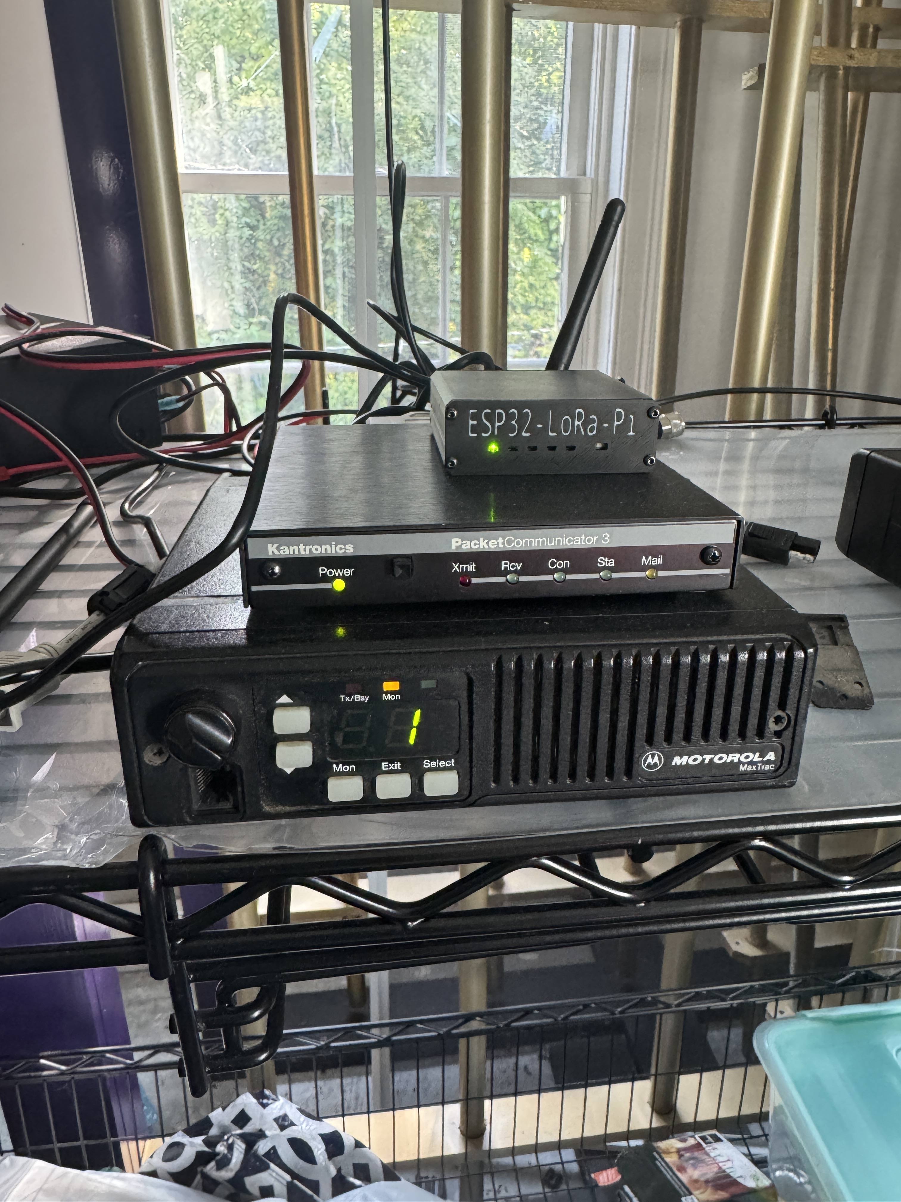
Easy to integrate!
Bought the device
Plugged it in
Reconfigured my aprsx on my Raspberry Pi
  May not be as easy for everyone
Instant cross band repeat

Slide 20
Antennas
Don’t use the stock antennas
Not only are they monopoles, they’re often terrible
Plenty of homebrew antennas for 33cm and 70cm
Meshtastic also keeps a good list of “buy these ones and not these ones”

Slide 21
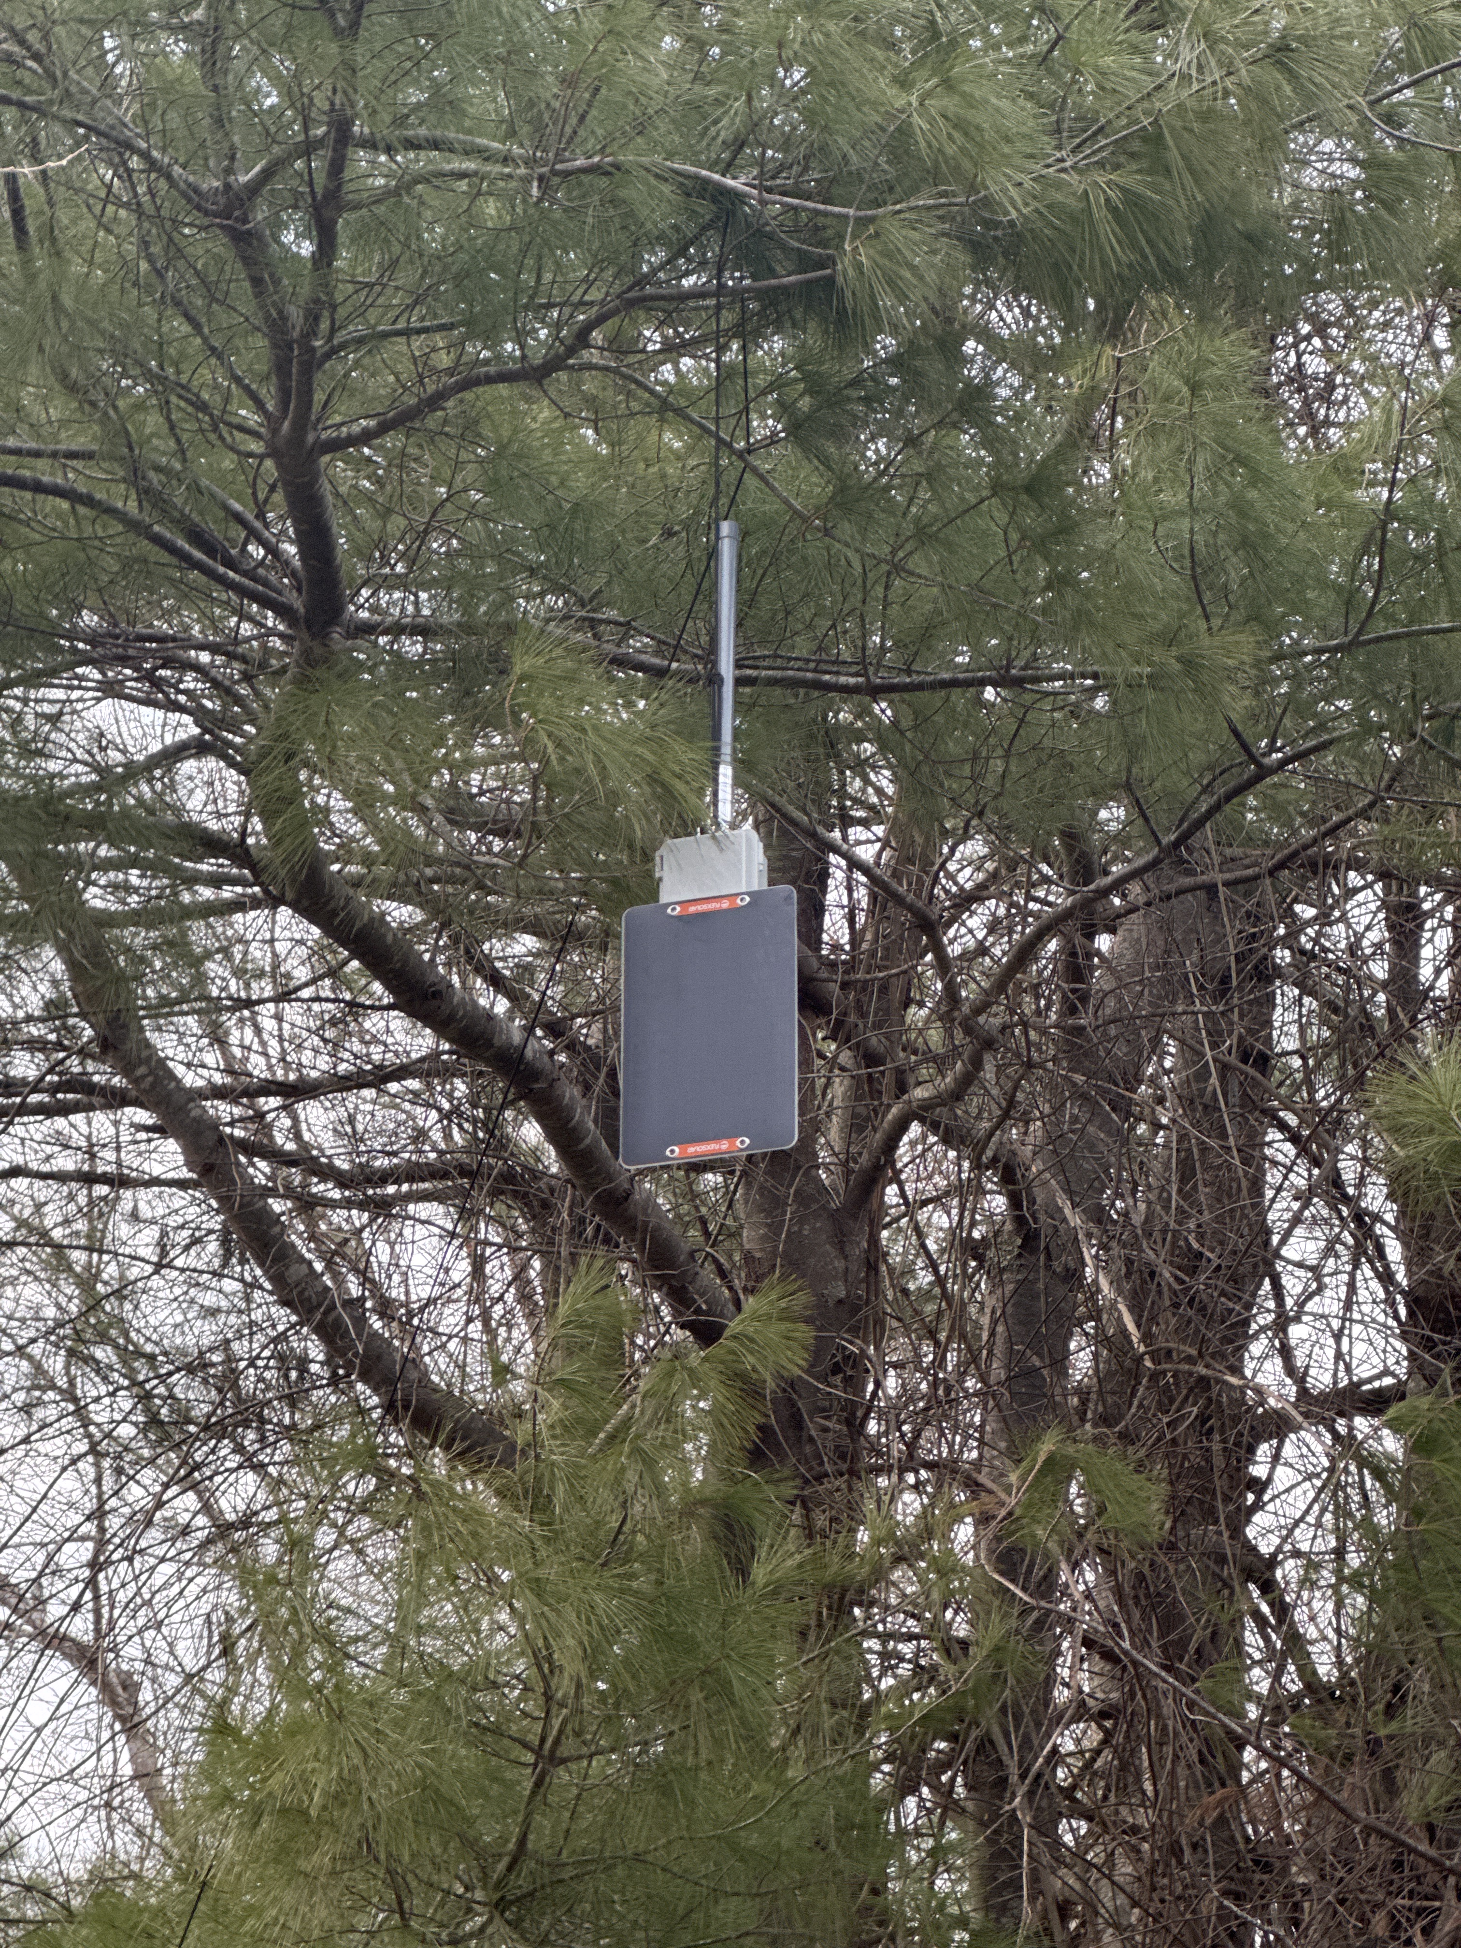
Power
These are not high power devices
Therefore low power consumption
Most boards have integrated charging capabilities
Some have solar capabilities
ESP32 devices draw much more power than NRF devices

Slide 22
Finally, your phone
Most of these devices have a tiny screen that can provide some data
Does not scale well
Your phone most often runs the software that you use to configure and interface with these devices, via Bluetooth
Some devices have WiFi interfaces as well

Slide 23
The Platforms

Slide 24
Quick Detour – Mesh Networks
Mesh Network
  No central hub - every node can help relay traffic for its neighbors
Peer-to-peer by design
  Nodes communicate directly with nearby peers rather than routing everything through a single base station.
Multi-hop relaying
  A message can travel node to node across many hops, extending coverage well beyond any single radio's range.
No single point of failure
  Because the network is decentralized, the loss of any one node rarely takes down the whole system.

Slide 25
Another Quick Detour - Routing
Flood routing
  Every node rebroadcasts a message to all its neighbors
  Simple and robust, but less efficient on busy networks
  Sometimes called Store-and-forward
  Meshtastic and MeshCom do this
Managed / routed mesh
  Nodes build routing tables and forward traffic along known paths
  Reduces redundant airtime and collisions
  MeshCore and APRS do this

Slide 26
Commonalities across platforms
All the systems have a number of commonalities
Telemetry
  Weather
  Location
  System Health (voltage, etc)
Messaging

Slide 27
Meshtastic
Created by Kevin Hester in early 2020
Solution for communication during hobbies where reliable internet access is unavailable
Flood routing
Really took off around 2024-2025
Currently the “most popular” mesh network
  By way of node count
Popularity ebbing due to MeshCore

Slide 28
Meshtastic
The best option to start your LoRa journey
$50, an amazon order, some firmware, and you’re in business
This is easiest way to go online and find someone to talk to
  Buy, flash, run
If youa re in Boston, Worcester, or other dense urban area, may not be the best
Again, flood routing

Slide 29
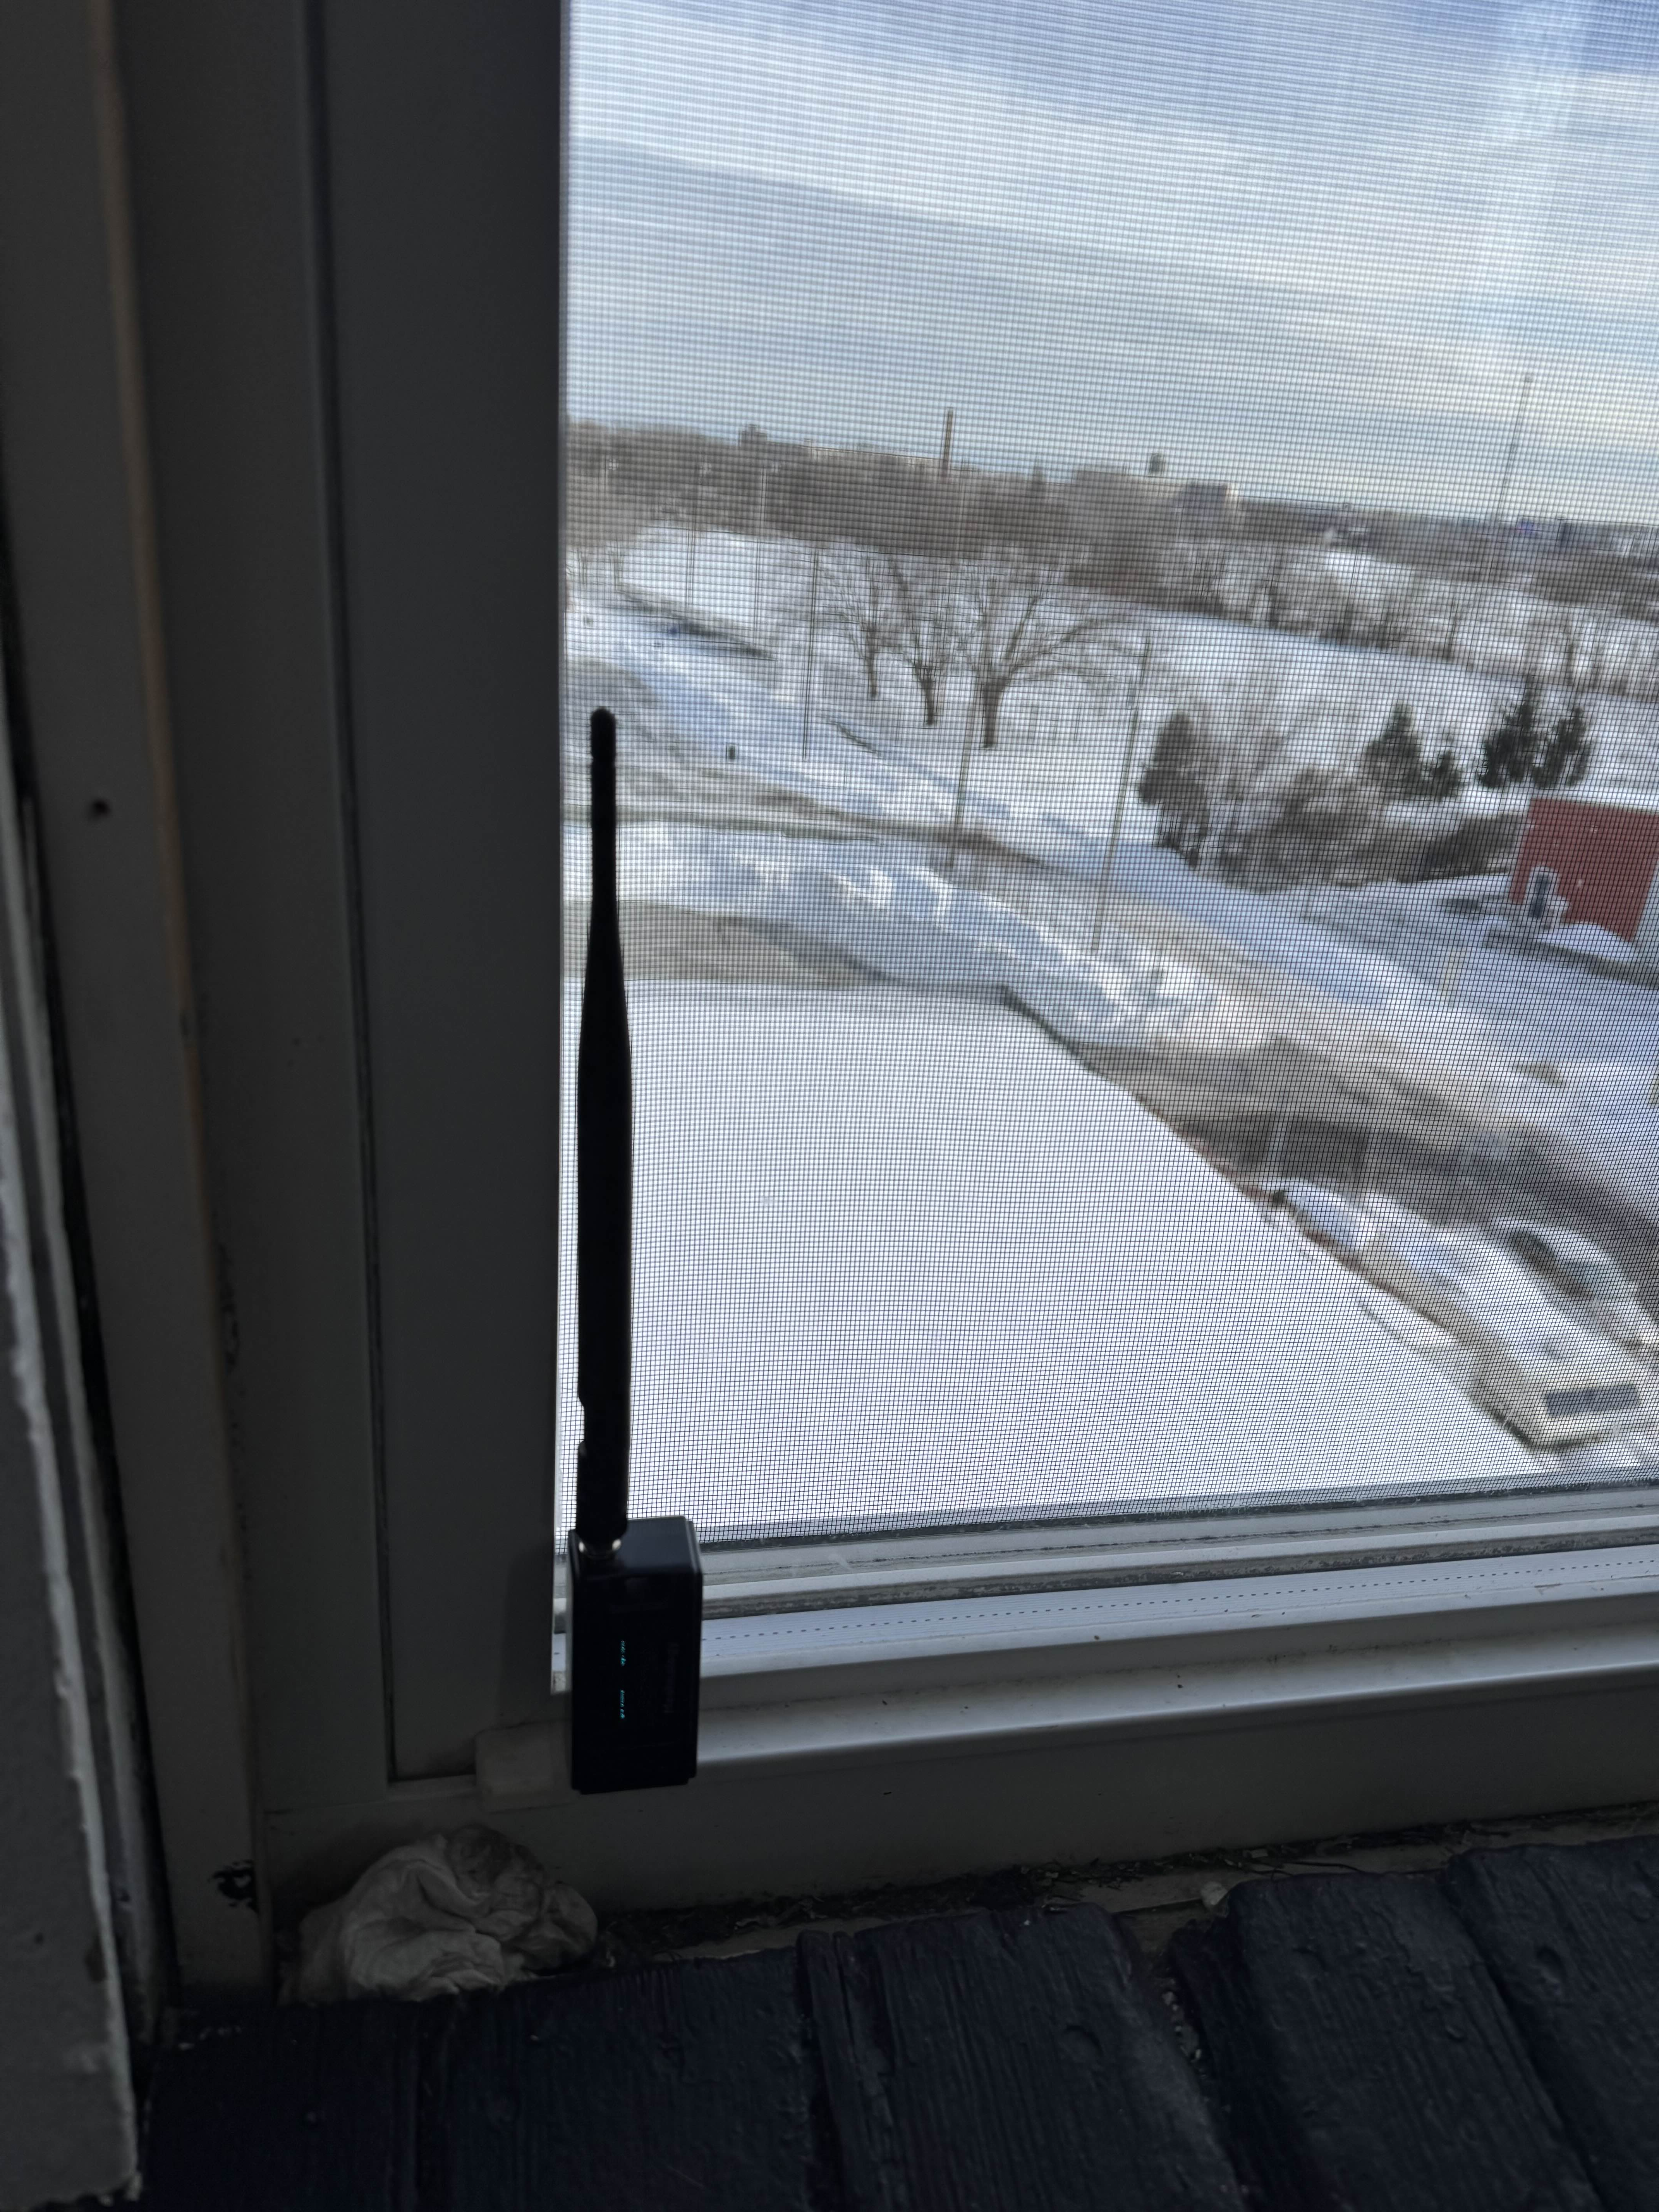
Why flood routing?
Super simple to create a mesh, even if by accident
As I did this past winter
Accidentally bridged two 100K+ cites together while at soccer practice

Slide 30
Meshtastic Bottom Line
Great for tactical networking with no fixed infrastructure
The best choice for finding someone in your area to talk
  Again, the most popular
Flood networking causes issues in dense environments
  Like cities… and conventions like HamX
  This is not a repeat from 2001 with APRS
Limited in hop distance when compared to other solutions
iOS and Android clients very different from each other

Slide 31
MeshCore
Developed in 2024 by Scott Powell
Alternative to Meshtastic
  Implemented after attempts to change Meshtastic away from flood routing
Not as popular of Meshtastic, but gaining popularity
  Especially in dense cities
Designed to fix the shortcomings of flood networking

Slide 32
MeshCore
Uses managed routing to better handle dense networks
Devices have roles
  Companions – Phones and other devices that are used by users
  Repeaters – Devices that route the packets
  Rooms servers – Bulletin Board Systems that store and forward messages
Because not everything floods blindly, collisions have a lower probability

Slide 33
MeshCore Bottom Line
People love MeshCore
It still has not achieved critical mass
  Yet…
MeshCore is having some internal political struggles
  Yay
  Not affecting the underlying hardware or software

Slide 34
MeshCom
Ham Specific Meshtastic Alternative
  Developed in Austria primarily by Kurt Baumann, OE1KBC
  Explicitly designed around ham operation
Flood routing
Integration with existing amateur radio stacks
Started in Austria, grew to Germany, now going across Europe
  United States? Not so much
Meshcom designed for 70cm, can be grafted on to 33cm
  Not for the faint of heart

Slide 35
Meshcom
“Native” APRS compatibility
  Via APRS-IS
Position and message traffic can flow into APRS-IS
  You show up on APRS.fi, etc
No messaging integration
No telemetry capabilties
Option for integrated LoRA APRS capabilities
  Tracker only

Slide 36
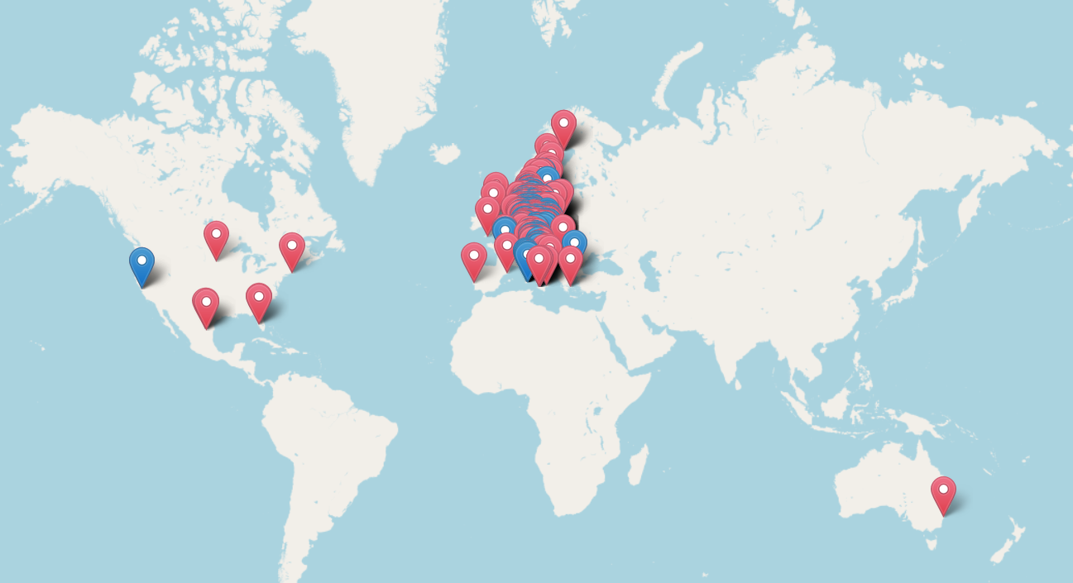
Meshcom Map

Slide 37
Meshcom Bottom Line
Ham mesh made by hams
There are pros and cons to having a mesh made by hams
  Ham integration, ham ingenuity… and ham coding
Rapid development often with limited testing
  Bugs and feature requests rapidly deployed
  A bit more stable over the past months

Slide 38
APRS
APRS stack can be pushed to LoRA easily
APRS does not care about the medium it’s transmitted on
CA2RXU has a great pieces of firmware for multiple devices
  Trackers
  iGates
  Digipeaters

Slide 39
APRS Bottom Line
Every fiber of my being hates this idea
  It’s 40 years old for cryin’ out lout
But, it works
  Really, really well
There is some advantage in that we have figured this stuff out over the life of APRS

Slide 40
Call to Action

Slide 41
Saddle up, folks!
We, as a community, need to start experimenting with this
At least learn to play with unlicensed Meshtastic
  Get a feel for the platforms
This is not new technology, and as a hobby we are supposed to be cutting edge
We, as amateurs, can take advantage of the 70cm allocation overlap with European bands
  Lets put a less popular band to better use!

Slide 42
“OK Ben, how?”
How many of you have a 2M/70cm antenna you are not using the 70cm being unused?
How many of you have a 2M repeater or APRS digipeater with the 70cm portion being unsed?
Why not put in a diplexer and a LoRA on the 70cm side?
  It doesn’t matter what you use, lets start generating RF
More activity = Less chance it will be taken away
Side note – We are fending off a threat to 33cm!

Slide 43
Demo time!

Slide 44

Questions?
Contact Information:
e-Mail: ben@n1wbv.net
Web: n1wbv.net

